Slide 1








PROJECT TOPIC
TELECOM CHURN
PREDICTION
Presented By
Abhishek Mukherjee (220950325001) Amardeep(220950325004)
Awad Amit Raosaheb(220950325005) Bakle Yogesh Balasaheb(220950325006) Bishwajit Sen(220950325007)

Slide 2
Guided By Ganga Prasad Sir
Batch:-DBDA SEP.2022
Course Co-ordinator Mr.Sadhu Sreenivas Sir

Slide 3
CONTENT
INTRODUCTION
Project objective Dataset description Steps
Data collection Data preprocessing Churn prediction
Telecom churn prediction architecture Methodologies
EDA
Advantages and Disadvantages Importance of churn prediction Application churn prediction Challenges of churn prediction Model selection
Flask
Finding and Suggestions
How to reduce Customer Churn Conclusion
Refrences

Slide 4
INTRODUCTION
CHURN Prediction is one of the most popular Big Data use cases in business.It consists of detecting customers who are likely to cancel a subcription to a service.
Churn is a problem for telecom companies because it is more expensive to acquire a new customer than to keep your existing one from leaving.

Slide 5

PROJECT OBJECTIVE
To predict Customer Churn
Highlighting the main Variables/factors influencing Customer Churn
Use various ML algorithms to build prediction models ,evaluate the accuracy and performance of these models.
Finding out the best model for our business case and providing executive summary
There are many ways: better products, better delivery methods,lower prices,building satisfactory customer relationships,better marketing and, above all, successful customer communications.

Slide 6
DATASET DESCRIPTION
Source dataset is in csv format.
Dataset contains 51047 rows and 24 columns.
There is no missing values for the provided input dataset.
Churn is the variable which notifies whether a particular customer is churned or not.And we will be developing our models to predict telecom churn.

Slide 7
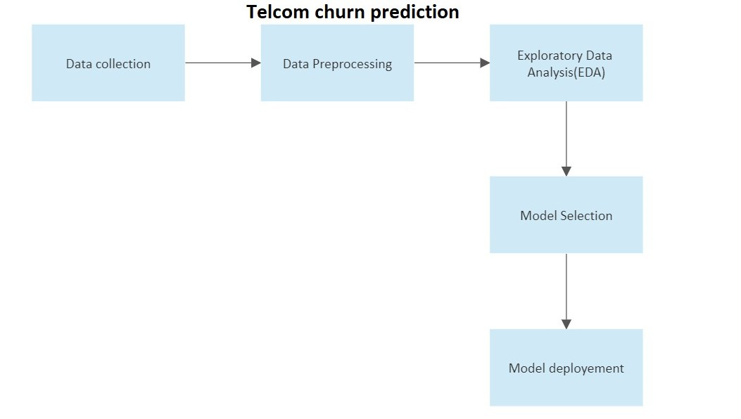
STEPS

Slide 8
DATA COLLECTION
Data collection is a crucial part of churn prediction in telecom. To build an effective churn prediction model, telecom companies need to collect large amounts of customer data, including:
Customer demographics: This includes data such as age, gender, location, and income.
Usage patterns: This includes data on how customers use telecom services, such as call and text patterns, data usage, and service plan subscriptions.
Billing data: This includes data on billing history, payment patterns, and account status.

Slide 9
DATA PREPROCESSING
Data preprocessing is the process of cleaning, transforming, and preparing raw data for analysis. It is an important step in data analysis as the quality and accuracy of the final results heavily depend on the quality of the preprocessed data.
Data preprocessing includes various tasks such as removing irrelevant or duplicated data, dealing with missing values, transforming the data into a suitable format, normalizing or scaling the data, and selecting the most relevant features for analysis.

Slide 10
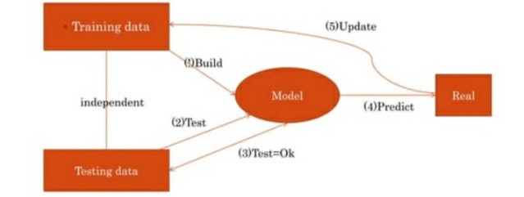
CHURN PREDICTION MODEL

Slide 11
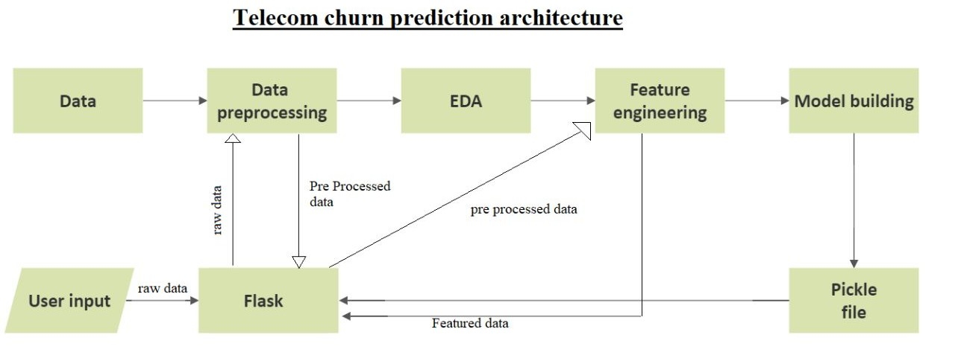
Telecom Churn Prediction Architecture

Slide 12
METHODOLOGIES
EDA(Exploratory Data Analysis): The dataset consist of 20 variables in all. A few are continous, rest are categorical. The control variable was customer.
Model building which includes defining the purpose if model, determine the model boundary build the model ,create an interface and export the model.
Evaluating machine learning algorithm is an essential part of project.

Slide 13
EXPLORATORY DATA
ANALYSIS
Data visualisation using seaborn and matplotlib
Exploratory data analysis (EDA) is an approach to analyse data sets and to summarize their main characteristics ,often with visual methods.
A Statistical model can be used or not, but primarily EDA is for seeing what the data can tell us beyond the formal modelling or hypothesis.

Slide 14
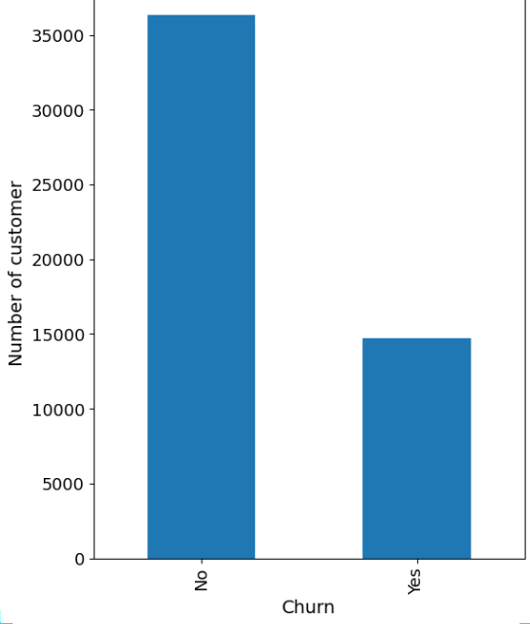
BAR GRAPH
Plot Shows that the users from the Data are likely to be Continuing their Subscription plan (>70%)

Slide 15
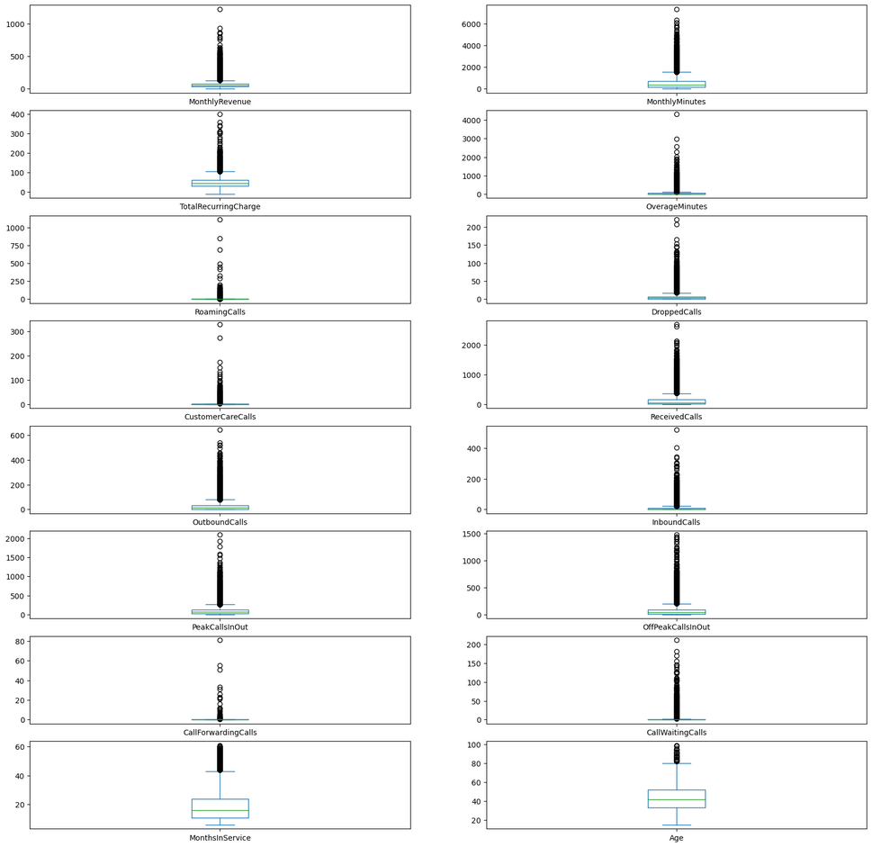
BOXPLOT
Regarding telecom churn prediction, box plots can be useful to identify potential predictors or variables that are strongly associated with customer churn. For example, if the box plot for a specific variable shows a significant difference between churned customers and non-churned customers, this could suggest that this variable is a strong predictor of churn.
We found outliers in exiting customers which is out of whiskers .An Outlier is an observation that is numerically distant from the rest of data.

Slide 16
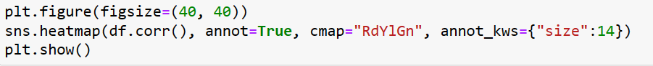
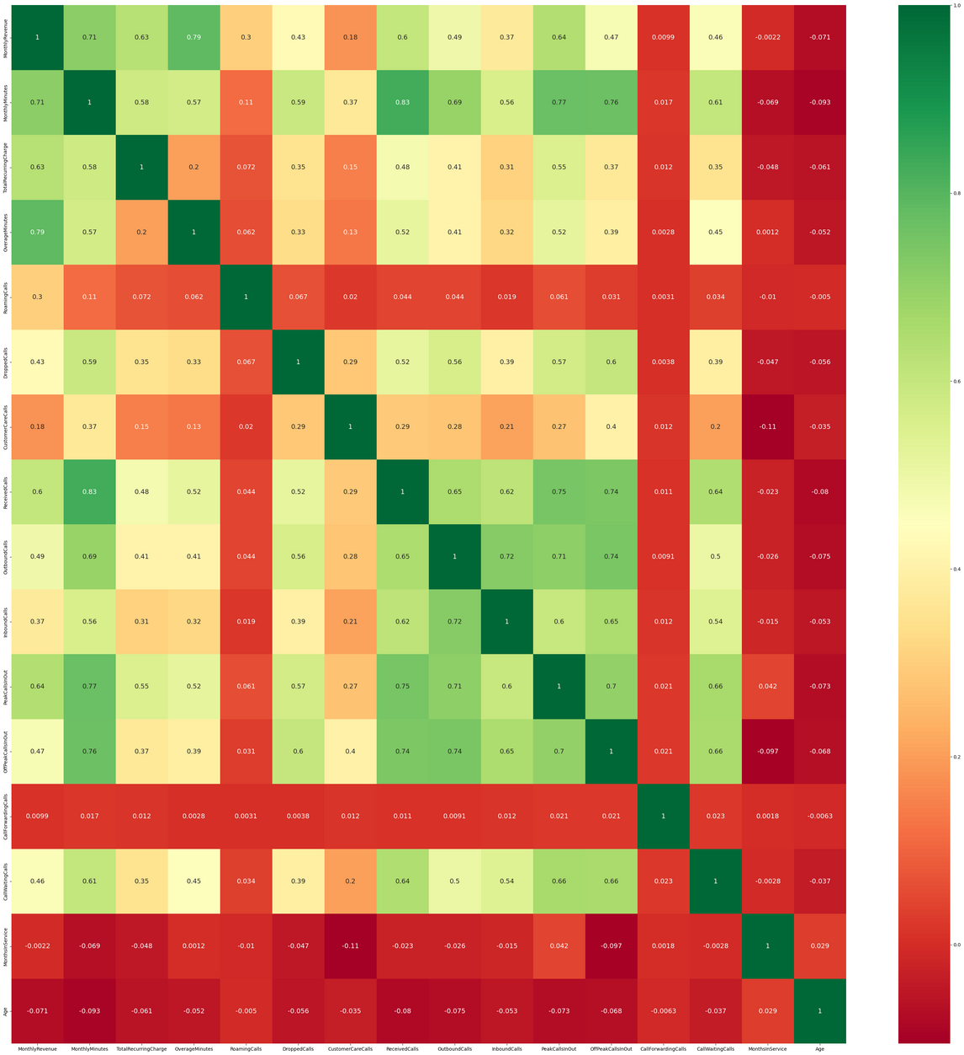

HEAT MAP
Correlation:- Dependence or association in any statistical is any statistical relationship, whether causal or not, between two random variables or bivariate data.
With the help of correlation matrix, we can find interdependency between variables.
Least dependency of variables for predicting churn are contract.
Churn variable is depending more on monthly charges.

Slide 17
CHURN PREDICTION CLASSIFICATION
CHURN
Prediction
Machine Learning
Supervised Learning
Unsupervised Learning
Decision Tree
LINEAR CLASSIFIERS
Rule -BASED Classifiers
Probabilistic Classifiers
Entropy
GINI Index
SVM
Naive Bayes
KNN
Maximum Entropy

Slide 18
Churn Prediction
Churn prediction is important for telecom companies because it is more expensive to acquire new customers than to retain existing ones. By identifying customers who are at risk of churning, telecom companies can take steps to retain them, such as offering discounts or promotions, improving the quality of service, or providing personalized customer support.
Machine learning techniques such as logistic regression, decision trees, and random forests are commonly used to build churn prediction models. These models can be evaluated using metrics such as accuracy, precision, recall, and F1 score, and can be fine-tuned using techniques such as cross-validation and hyperparameter optimization.

Slide 19

ADVANTAGES
Competitive Advantage: Companies that are able to effectively predict and prevent churn can gain a competitive advantage in the market by retaining customers and reducing customer acquisition costs.
Data-Driven Insights: Churn prediction models provide valuable insights into customer behavior and preferences, which can be used to inform marketing and product development strategies.
Increased Revenue: By reducing churn rates and retaining customers, telecom companies can increase revenue and profitability.

Slide 20
DISADVANTAGES
Data Quality: Churn prediction models are only as good as the data they are built on.
If the data is incomplete, inaccurate, or biased, the model may produce inaccurate or misleading predictions.
Overfitting: Churn prediction models can be prone to overfitting, which occurs when the model is too closely fitted to the training data and performs poorly on new data.
This can result in inaccurate predictions and reduced effectiveness.

Slide 21
IMPORTANCE OF CHURN
PREDICTION
Retaining Customers: One of the main benefits of churn prediction is the ability to identify customers who are at risk of leaving and take proactive steps to retain them. This can help companies reduce churn rates and retain valuable customers.
Cost Savings: Acquiring new customers can be expensive, so reducing churn rates can result in significant cost savings for telecom companies.
Increased Revenue: By reducing churn rates and retaining customers, telecom companies can increase revenue and profitability.

Slide 22
APPLICATIONS OF CHURN
PREDICTION
Retention Strategies: Churn prediction models can be used to identify customers who are at risk of churning and develop targeted retention strategies to retain them.
Customer Segmentation: Churn prediction models can be used to segment customers based on their churn risk and develop targeted marketing campaigns for each segment.
Pricing Strategies: Churn prediction models can be used to identify customers who are price-sensitive and develop pricing strategies to retain them.

Slide 23
CHALLENGES OF CHURN
PREDICTION
Data Quality: One of the most significant challenges in churn prediction is ensuring the quality of the data. Poor data quality can lead to inaccurate or biased predictions.
Feature Selection: Selecting the most relevant features to use in churn prediction can be challenging, especially given the large amounts of data involved.
Overfitting: Churn prediction models can be prone to overfitting, which can lead to poor performance on new data.

Slide 24
MODEL SELECTION
Model selection is the process of selecting the best algorithm or model from a set of candidate models for a particular task or problem. In the context of machine learning, model selection involves evaluating different models and selecting the one that performs the best on a given dataset.
The goal of model selection is to choose a model that generalizes well to new data and provides the best possible accuracy and performance for the given task. Model selection involves evaluating different models using various performance metrics such as accuracy, precision, recall, F1-score, and AUC-ROC.

Slide 25
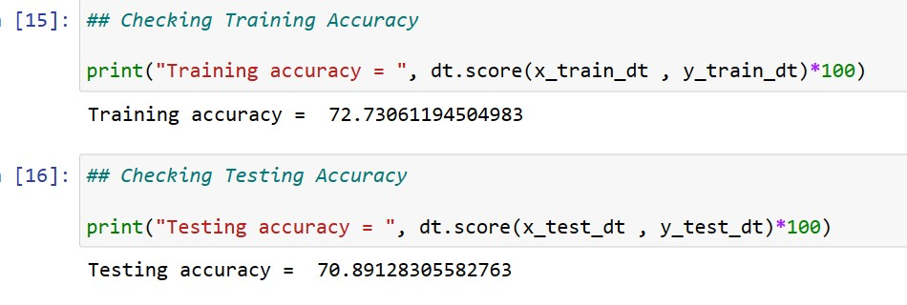
DECISION TREES
Decision trees are often used in classification problems, where the goal is to predict the class of an object based on its features or attributes. They can also be used in regression problems, where the goal is to predict a continuous value based on a set of input
variables.

Slide 26
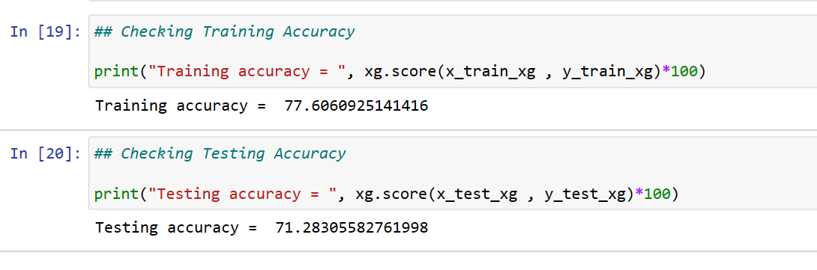
XGBoost Classifier
The XGBoost classifier is particularly well-suited to large datasets with many features, as it can handle both numerical and categorical data. It is also highly customizable, with many parameters that can be tuned to optimize performance for specific problems.

Slide 27
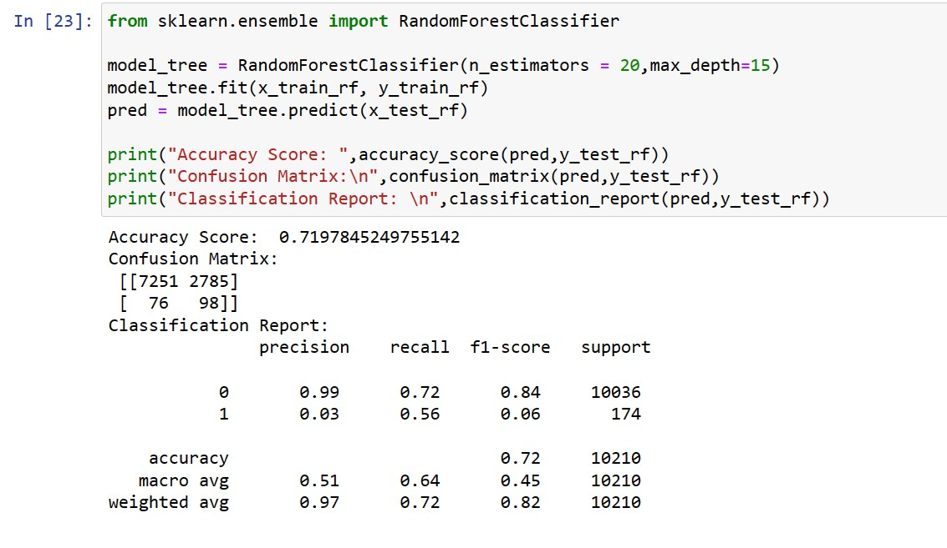
Random Forest

Slide 28
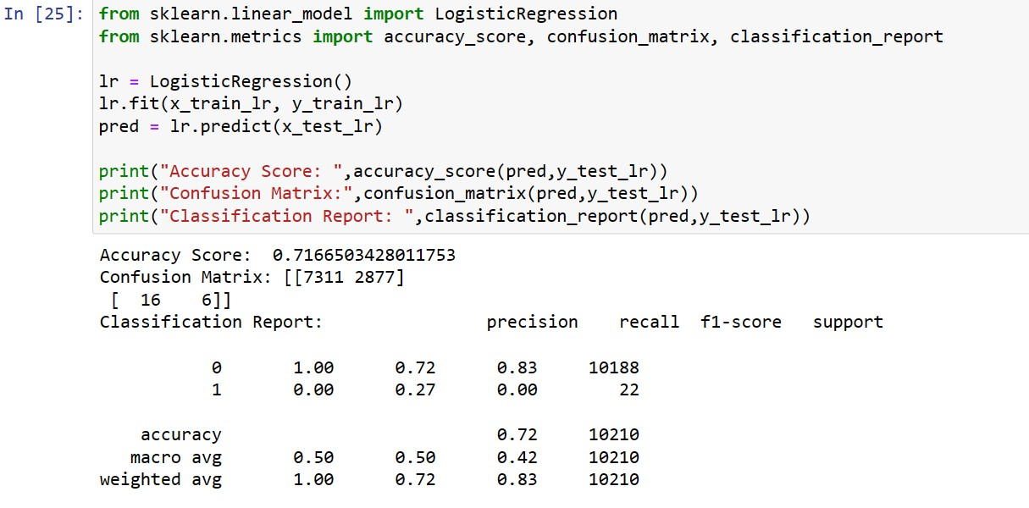
Logistic Regression

Slide 29
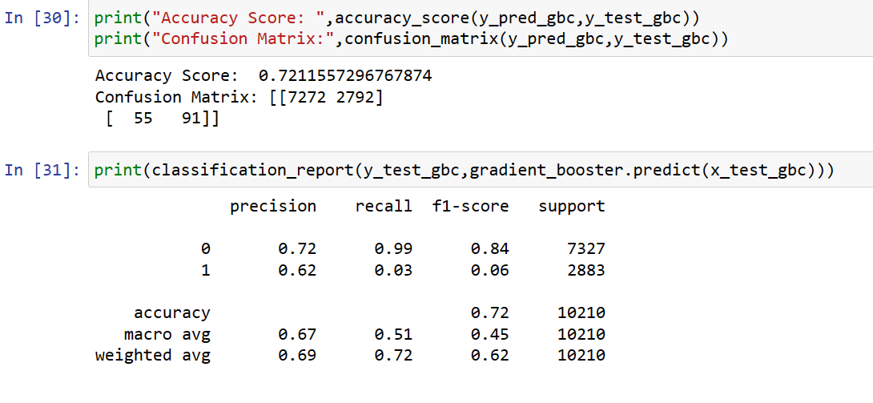
GradientBoostingClassifier

Slide 30
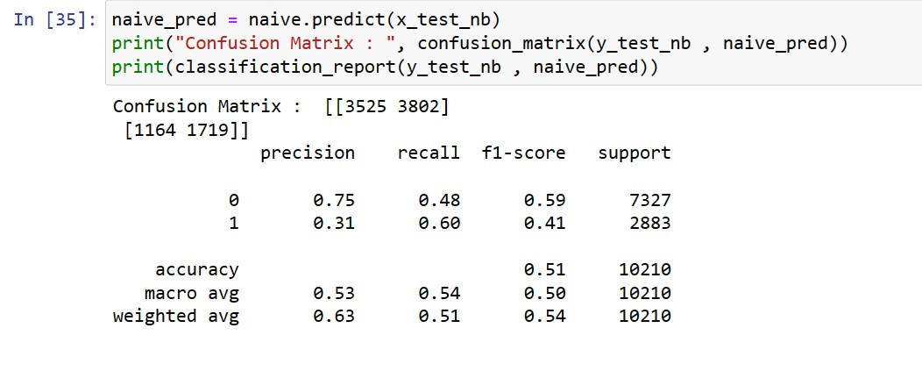
Naive Bisen Classifier

Slide 31
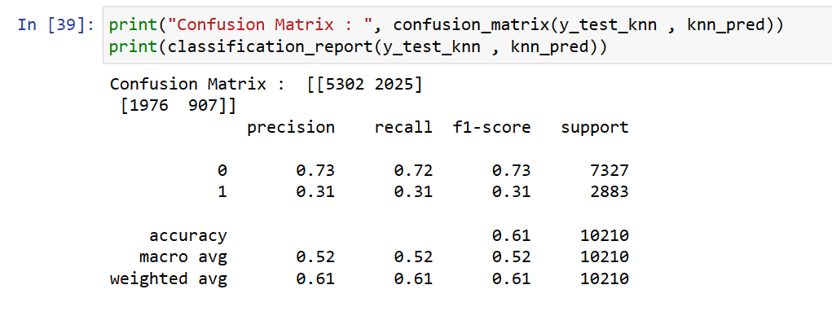
KNN Classifier

Slide 32
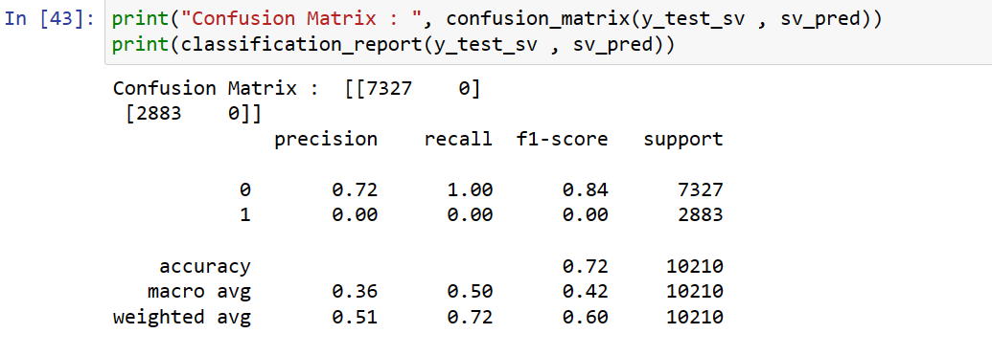
SVM (Support Vector Machine)

Slide 33
FLASK (Front End Using For To
Show In Application)
Flask is a Python web framework that allows you to build web applications quickly and easily. It is a lightweight framework that is easy to learn and simple to use, making it a popular choice for web developers. Flask provides the basic features and tools needed to build a web application, while also allowing for customization and extensibility through its modular design.
Flask is often used for building small to medium-sized web applications and APIs, but it can also be used for larger applications with the help of extensions and plugins. Flask's flexibility and simplicity make it a popular choice for many developers.

Slide 34
FINDING AND SUGGESTIONS
Try to offer the better service for churn customers ,see how much this impact before and later .Some may use your services better move them to your active customers.
Take the feedback and suggestions with in period of time and improve it ,strive for better communication.
When your are taking the any change in plans of your business just predict the positive and negative share of that plan .If it is negative prepare the solution before so You can handly easily.

Slide 35
HOW TO REDUCE CUSTOMER
CHURN
Learn into your best customer.
Be proactive with communication.
Define a roadmap for your new customers.
Often incentives Ask for Feedback often.
Analyze churn when it happens.
Stay competitive.

Slide 36
CONCLUSION
The importance of this type of research in the telecom market is to help companies make more profit.
It has become known that predicting churn is one of the most important sources of income to Telecom companies.
Hence,this research aimed to build a system that predicts the churn of customers in telecom company.
These prediction models need to achieve high AUC VALUES.To test and train the model ,the sample data is divided into 70% for training and 30% for testing.

Slide 37
REFRENCES
h ttps://www.slideshare.net/PinintiHarishReddy/telecom-churn-prediction- presentation
h ttps://in.search.yahoo.com/search?
f r=mcafee&type=E211IN826G0&p=telecom+churn+prediction h ttps://in.search.yahoo.com/search?
f r=mcafee&type=E211IN826G0&p=dataset+telecom+churn+prediction
(KAGGLE)
h ttps://towardsdatascience.com/end-to-end-machine-learning-project-telco-
customer-churn-90744a8df97d

Slide 38
THANK YOU
Any Question??

